Slide 1



Library Management System With Database Connectivity
PROJECT MEMBERS
NAVEENA S 23ITR110
NANDEESH G 23ITR107
MOHAMMED YUNUS A 23ITR099
JAIHARI D (19ITR028

Slide 2
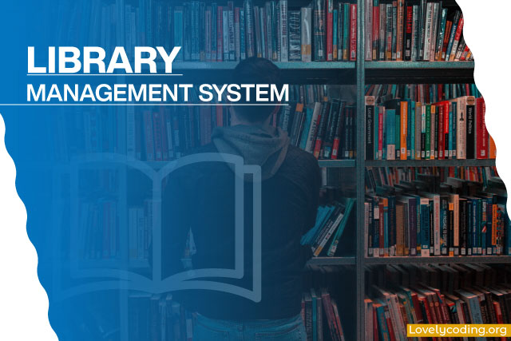
Problem Description
Designing a Library Management System that allows users to manage book inventories, track book usage and return, and manage user accounts.

Slide 3
Objectives
Efficient Book Management
User and Member Management
Stock and Return Tracking
Secure Database Connectivity
3

Slide 4



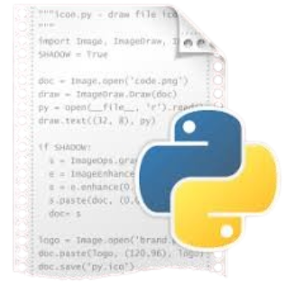

Software Tools Used
Python
Sqlite
Maria DB
Platform Used
Python Idle
GitHub (Hosting)
4

Slide 5
Reference
Library Thing
https://www.librarything.com
Library Management System overview
https://www.Imsoverview.com
https://www.researchgate.net
https://www.nios.ac.in
https://digitalcommons.unl.edu
https://www.skoolbeep.com
5

Slide 6
Modules
Book Management Module
Availability Module
Membership Module
User Module
Admin Module
Recommandation Module

Slide 7
About Modules
Book Management Module:
Manages book records, including adding, updating, and deleting.
Availability Module:
Tracks real-time book availability and manages reservations.
Membership Module:
Handles user registration and membership status management.
User Module:
Displays issued books and tracks user borrowing history.
Admin Module:
Manages users and displays admin details for oversight.
Recommendation Module:
Suggests personalized book recommendations based on user preferences.

Slide 8
THANK YOU

